Slide 1
QuickCart UI
Concepts + Design

Slide 2
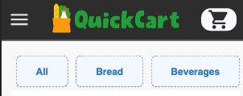
Browse
Menu Bar
Search for images with brand + product name
(enter manually)
Category Selector
Product Cards
Number input for size, then unit dropdown

Slide 3


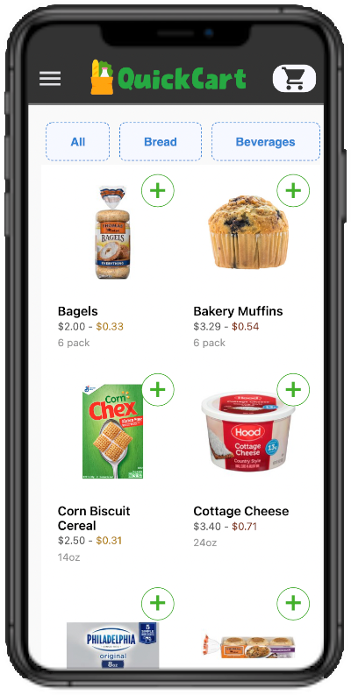




https://grocery-client-sl.herokuapp.com/
> users
- userGroceries
- userCart
- userCartLogs

Slide 4
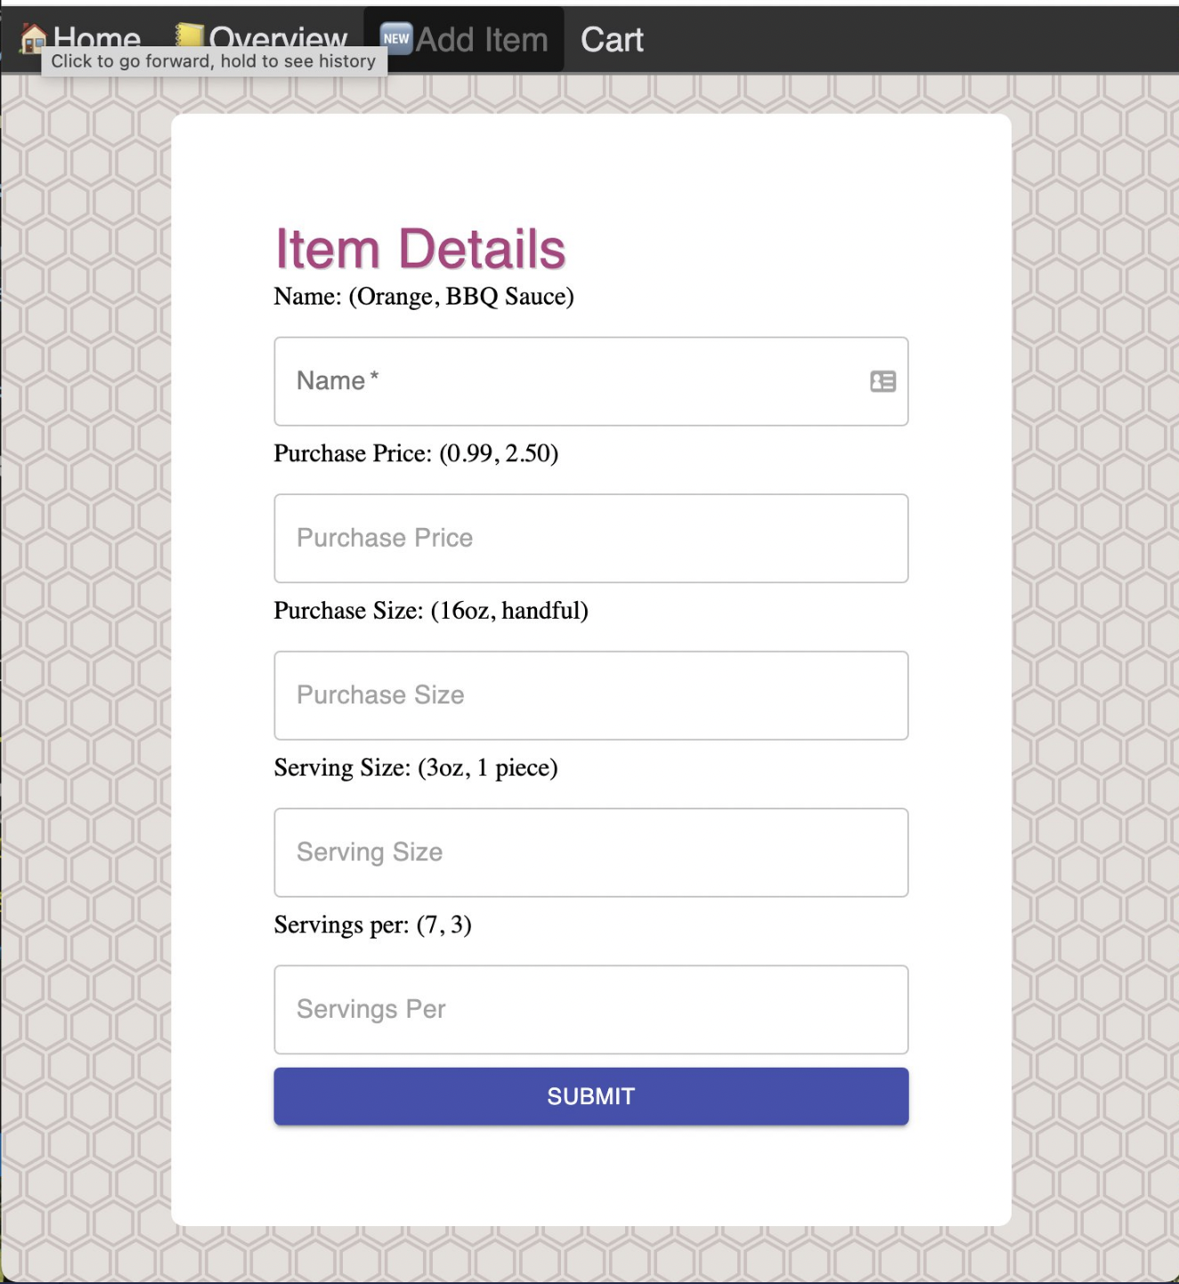
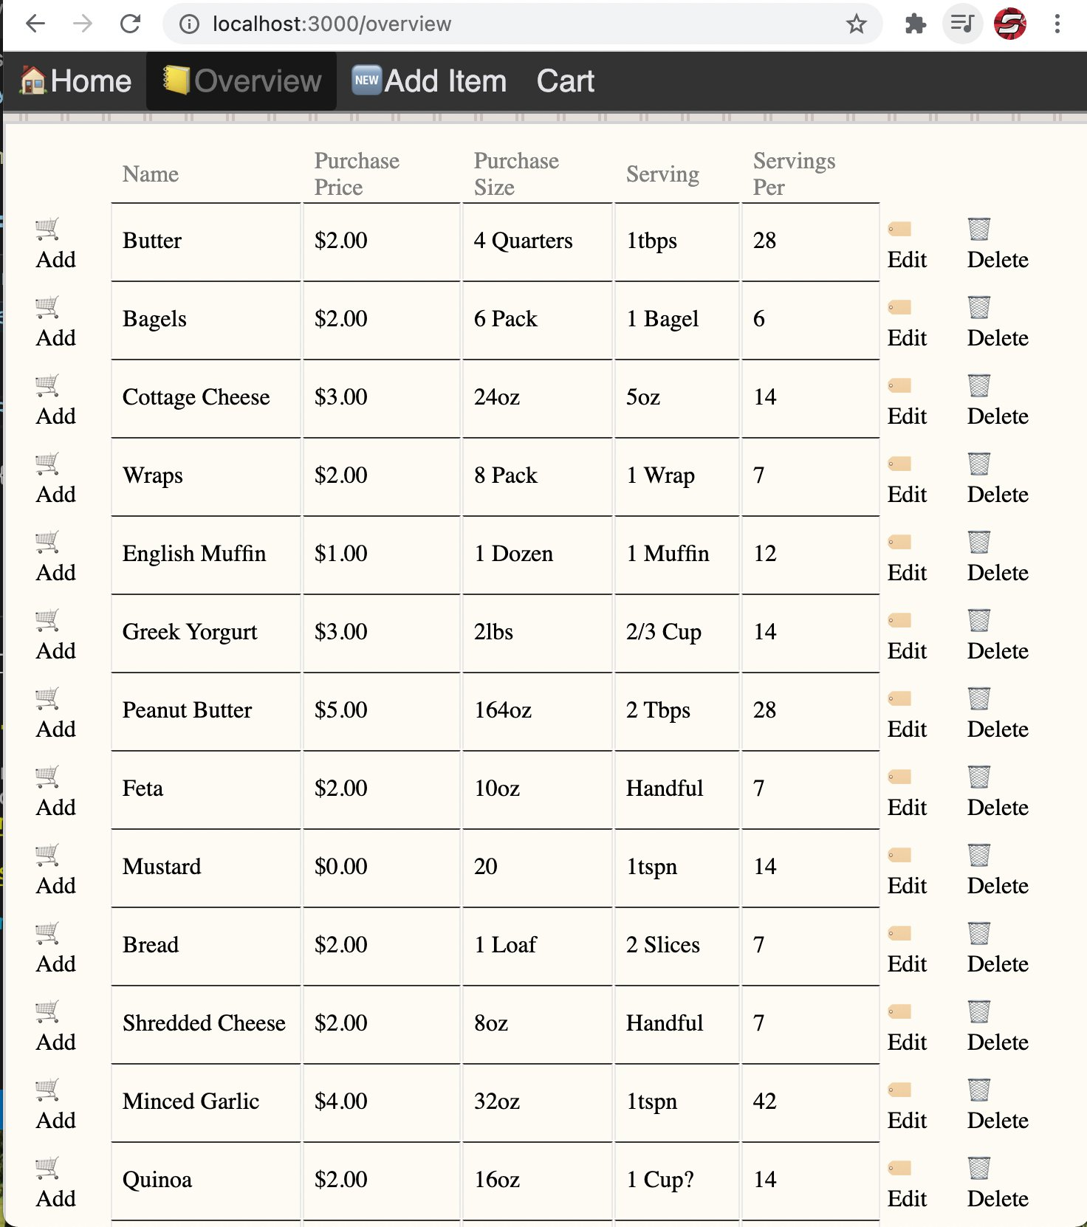

Slide 5
Browse
Menu Bar
Category Selector
Product Cards

Slide 6
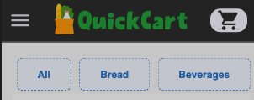

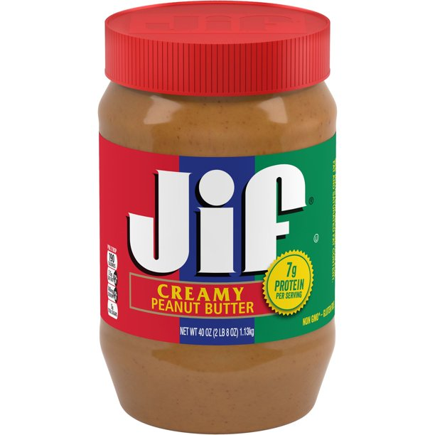
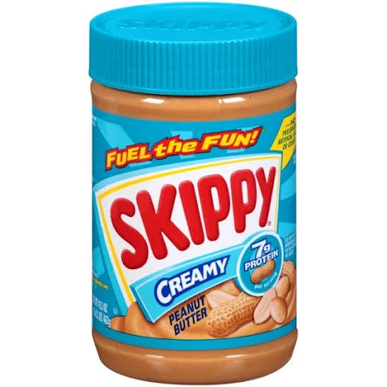

Product Card
Product Card
Nutrition Score
Product Name
A
B
Price (w/ serving cost indication)
B
Purchase Size
Jif Peanut Butter
Skippy Peanut Butter
$3.49
16oz
$2.79
16oz
Skippy Peanut Butter
Expand button
$2.79
16oz
Add to cart button
Product Image

Slide 7
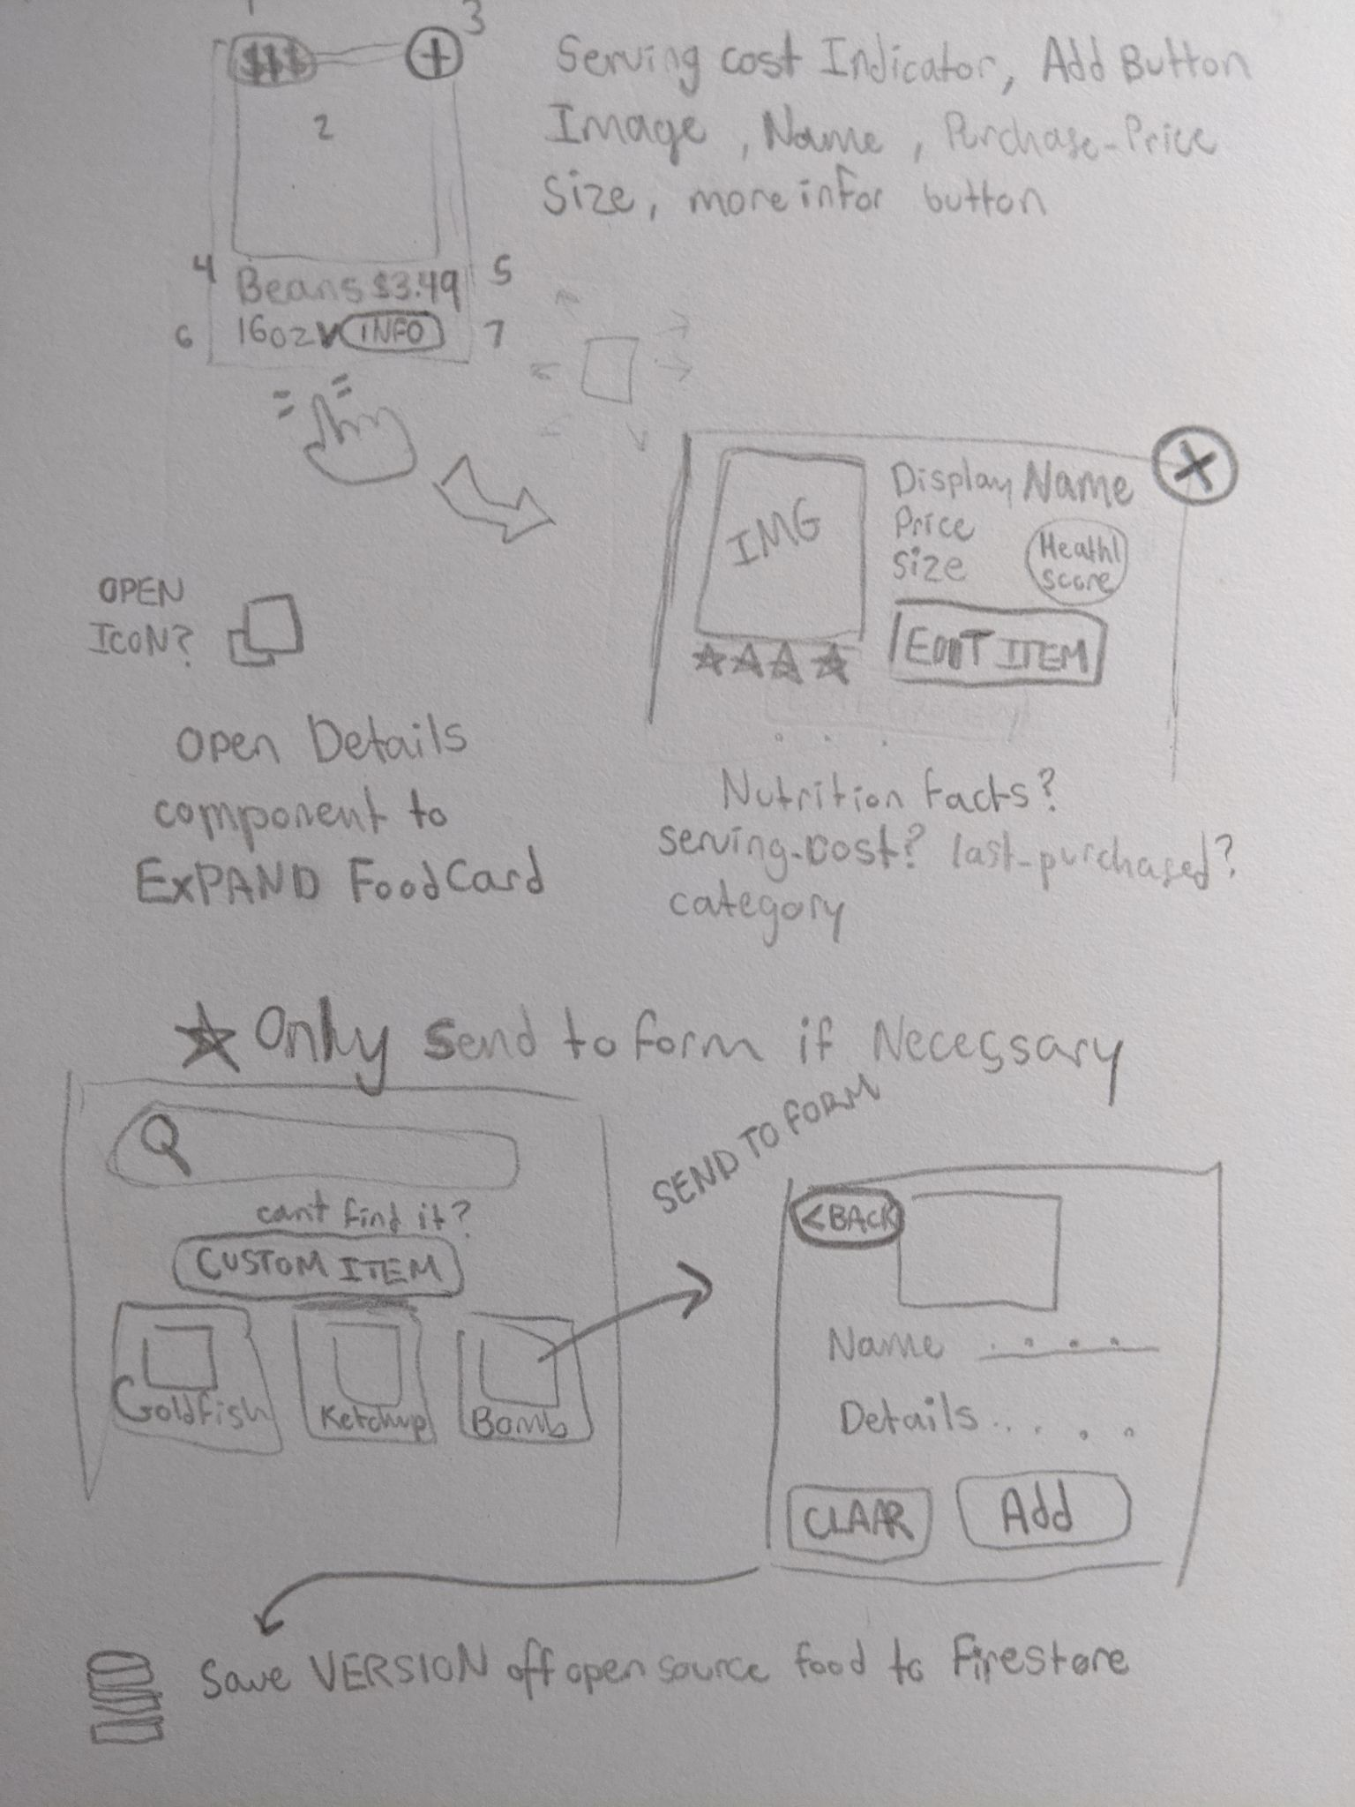

Slide 8
